Slide 1

CS 455: Introduction to Distributed Systems Affiliation: Computer Science Department, Colorado State University
Analyzing Relationships among Social Vulnerability Index factors, Crime Cases and Covid Cases
By Nick Kowalczyk, Rakibul Talukder, Banik Mrudul

Slide 2
Does socio-economic status, access to transportation, household composition, minority status and crime influence the likelihood of contracting and surviving COVID-19
Background
ARC-GIS tools
Government Policy
Pandemic Response
Social Response

Slide 3
Problem Characterization
SVI factors: Socio-economic, household composition, minority status, transportation by county
Crime: Total crime cases by county
Covid: Total cases & death total by county for 2020 & 2021
States: CO, TX, KA, KY, VG, MO, IO
Finding positive or negative correlations
Minimum / maximum values for each state
Difficulties:
Accurate reporting
Access to resources
Scale of pandemic
Varying responses
Social & legal by state/ county/ local
Unbiased
Compiling data from various sources

Slide 4
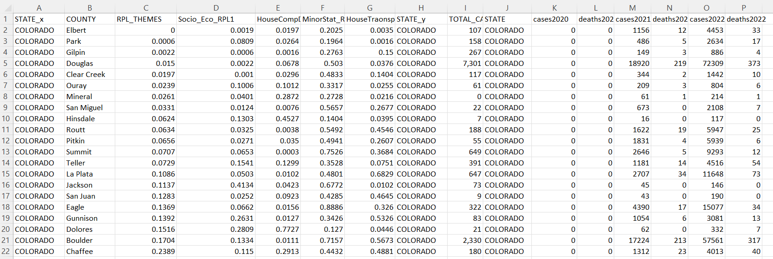
Methodology [1/3]
Merged Data
Datasets Collection
1) SVI Index Dataset 2) Covid Cases Dataset 3) Crime cases dataset
Data Conversion and formatting
SVI : We collected the data in json format. Selected SVI index and 4 factors into dataframe and converted into csv file.
Crime : We downloaded data in xls format. And converted to csv
Covid : Data in json format. Selected total cases, death totals, and data for years 2021 & 2021 and converted into csv
Merged Data : Join three csv files with python

Slide 5
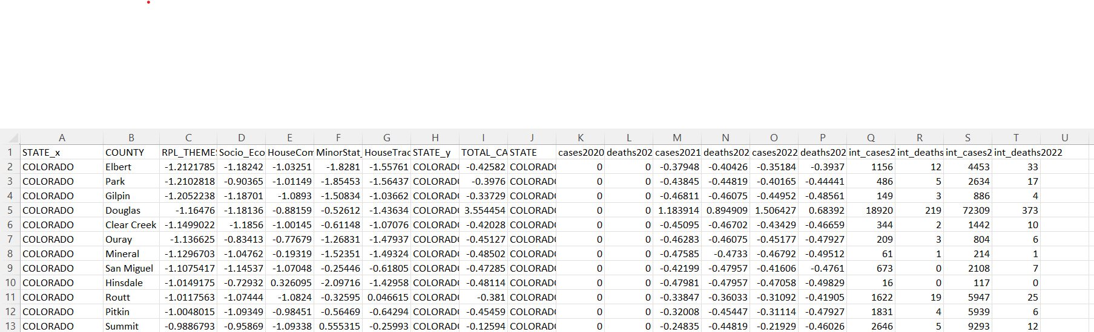
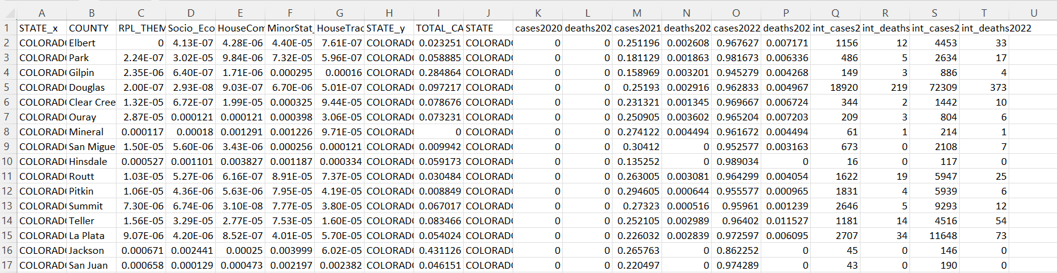
Methodology [2/3]
Merged Data after Scaling
Data Processing
Filling empty cells with average
Standard Scaler
Reduce variance by making feature centered around 0
Have negative values
Used Sklearn library
Normalizer()
does scaling individual samples to have unit norm
Have only positive values
Used Sklearn library

Slide 6
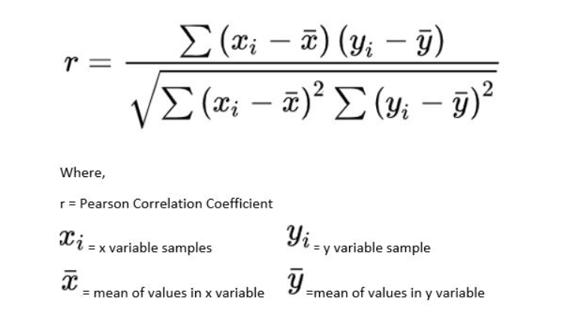
Methodology [3/3]
Analysis : Apache Spark with Scala Programming
Used Pearson Correlation Coefficient
Selecting columns from merged data passed into
correlation function. Gets result from -1 to 1
close to 1 represents strong correlation and close
to 0 represents weak correlation. Calculated
state wise correlation with SVI, Crime and covid case data
Find Maximum and minimum covid cases and covid death cases of 2020 and 2021
Write output file in text

Slide 7
Performance Benchmark[1/3]
Experiment Environment
OS : Linux
Hadoop
Performance
13 worker nodes
Each run : find all correlations for one state
Combined Data
Row: counties per state
SPARK Framework
Analysis : Scala
Preprocessing Data: Python
Each run time : around 20s
Column : 20 Attributes
CO: 51
IOWA: 98, KA: 71
KY:128, MO: 24
TX: 162, VG: 99

Slide 8
Performance Benchmark[2/3]
Attribute 1 | Attribute 2
Total Crime Cases | Socioeconomic status
 | Household composition & disability
 | Minority status & language
 | Housing type & transportation
SVI Index | Covid case 2020
 | Covid death case 2020
 | Covid case 2021
 | Covid death case 2021
Total Crime Cases | Covid case 2020
 | Covid death case 2020
 | Covid case 2021
 | Covid death case 2021
Correlation(Attribute1 , Attribute 2)
SVI – Crime
Crime – Covid
SVI - Covid
12 types of correlations for each state
Correlation performed on both normalized and standardized data
Maximum minimum of covid cases for year 2020 & 2021
Similarity/dissimilarity in correlation type
Consistency/inconsistency of behavior across states

Slide 9
Performance Benchmark[3/3]

Slide 10
Insights and Conclusion
Assumption about datasets: Each state may have similar kind of dependency relationship among SVI, crime and covid defined by counties
Insight 1: Correlation values of socio-economic status, access to transportation, household composition, minority status with total crime cases are closer to each other per state.
Insight 2: Correlation values of SVI with covid and Crime with covid are also closer to each other per state
Assertion 1: From insight 2 we can say SVI and crime has same kind of dependency relation on covid cases for each state
Assertion 2: From insight 1 and 2, we can say assertion 1 is consistent across all the states we have considered.

